Slide 2
Management of ankle fractures in the elderly
M. Tavakoi MD
IOA Tabriz webinar
1400.03.07

Slide 3
Objective
Specific reference to comorbidities
Current treatment approach

Slide 4
Problems in elderly patient with ankle fractures
Operative treatment
Higher rates of complication (osteoporosis, diabetes, peripheral vascular disease, obesity)
Non operative treatment
Higher rates of malunion and nonunion
Poor bone quality
More complicated fracture patterns
Problems with fixation
Rammelt, Stefan. "Management of ankle fractures in the elderly." EFORT Open Reviews 1.5 (2016): 239-246.
Davidovitch, Roy I., et al. "Functional outcome after operatively treated ankle fractures in the elderly." Foot & ankle international 30.8 (2009): 728-733.
Notes:
A wealth of clinical studies has shown higher complication rates after operative treatment of ankle fracture in patients are nearly identical, while non-operative treatment leads to significantly inferior outcomes.
Ali, M. S., et al. "Ankle fractures in the elderly: nonoperative or operative treatment." Journal of orthopaedic trauma 1.4 (1987): 275-280.

Slide 5
Evaluation of elderly patients with ankle fractures
Fx. with no significant trauma: history for an osteoporotic or pathological fracture
Clinical examination: acute deformities, open wounds and soft tissue condition
Neurological disorder: dry and scalding skin, claw toes, subtle cavus, loss of protective sensation in the sole of the foot
Rammelt, Stefan. "Management of ankle fractures in the elderly." EFORT Open Reviews 1.5 (2016): 239-246.
Notes:
Above all=loss of protective sensation in the sole of the foot

Slide 6
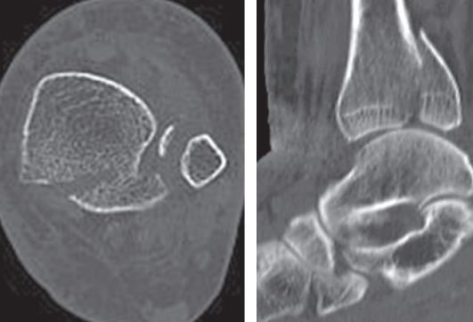
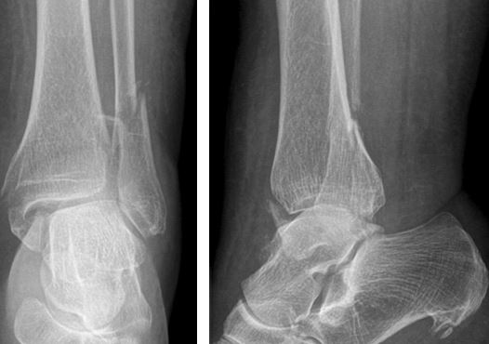
Diagnosis of an ankle fracture
X- ray
CT scan
CT scan
Complex fracture, post tibial fragment, impaction of the tibial plafond
Fracture-dislocations
Planning the operative approach
Post reduction and ext.fix.
79-year-old woman
Bartoníček, Jan, et al. "Anatomy and classification of the posterior tibial fragment in ankle fractures." Archives of orthopaedic and trauma surgery135.4 (2015): 505-516.
Notes:
Rammelt, S., H. Zwipp, and T. Mittlmeier. "[Operative treatment of pronation fracture--dislocations of the ankle]." Operative Orthopadie und Traumatologie25.3 (2013): 273-91.
Complex fracture which cannot be assessed reliably with standard x-ray. like post. tibial fragment, suspected impaction of the tibial plafond

Slide 7
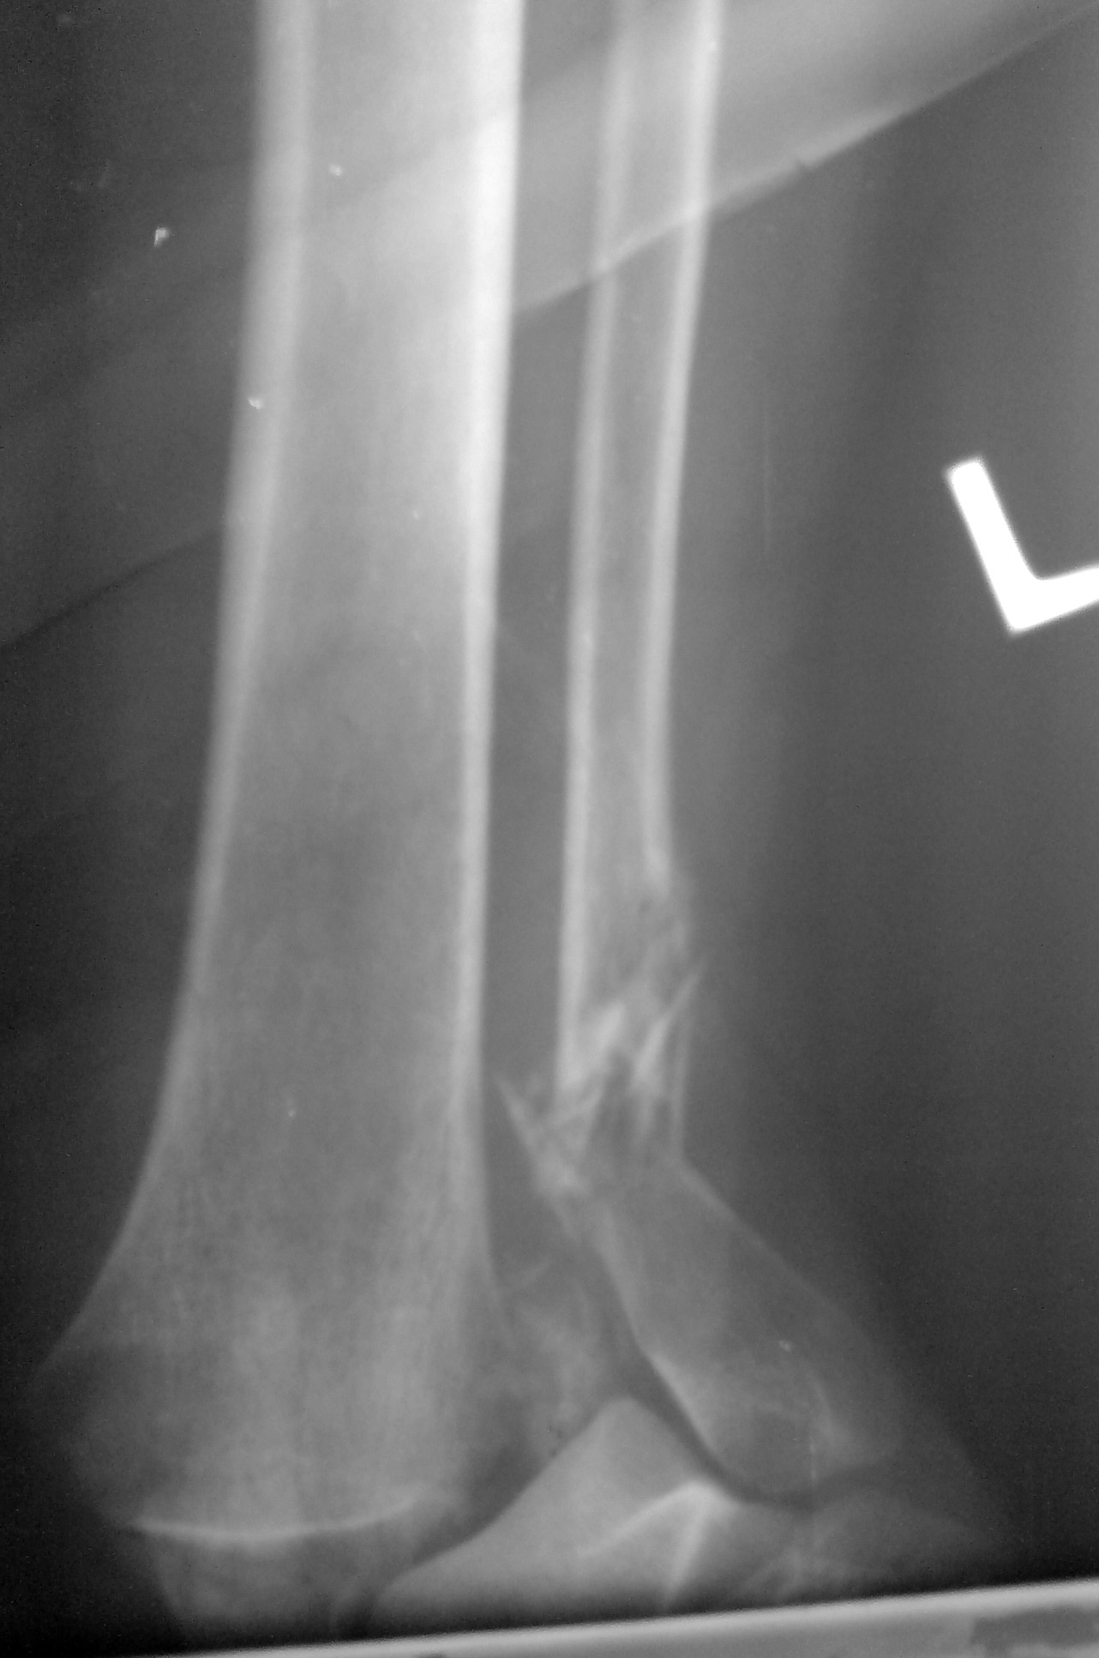
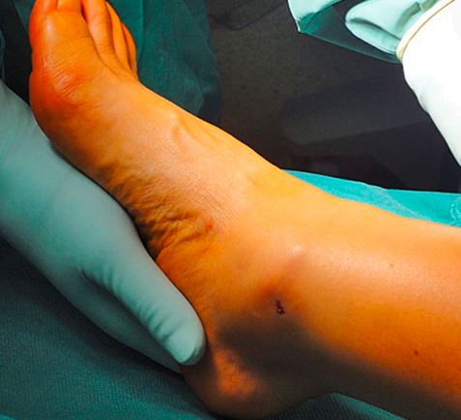
Emergency treatment
Grossly displaced fx-dx, impeding skin necrosis Immediate reduction
Open fractures
Closed fractures with subcutaneous stripping, Morel Lavallee lesion
Compartment syndrome
Rammelt, Stefan. "Management of ankle fractures in the elderly." EFORT Open Reviews 1.5 (2016): 239-246.
Notes:
Fracture-dislocation with impeding skin necrosis produced by a prominent medial fragment of the distal tibia. Immediate reduction is warranted.

Slide 8
Non-operative treatment
Stable and non-displaced fractures
Isolated fibular fractures without additional syndesmotic or medial ligament ruptures
Isolated undisplaced medial malleolar fracture without syndesmotic or lateral instability
Rammelt, Stefan. "Management of ankle fractures in the elderly." EFORT Open Reviews 1.5 (2016): 239-246.
Notes:
Control radiographs are obtained at one week after the injury to rule out secondary dislocation.

Slide 9
Non-operative treatment
Stable fx: 6ws orthosis or a special walker/boot neutral position, limited supination
Poor bone quality: Cast immobilization with off-loading until radiographic evidence of bone healing
Charcot neuro-osteo-arthropathy: Well-padded total-contact cast complete off- loading, prolonged immobilization
Rammelt, S., H. Zwipp, and W. Schneiders. "Treatment strategies for Charcot-osteoarthropathy." Osteologie 23 (2014): 107-16.
Rammelt, S., et al. "[Problems and controversies in the treatment of ankle fractures]." Der Unfallchirurg 114.10 (2011): 847-860
Notes:
Stable fx: 6ws orthosis or a special walker/boot in neutral position, limited supination under full weight-bearing
Control radiographs are obtained at one week after the injury to rule out secondary dislocation.
In patients with Charcot neuro-osteo-arthropathy, prolonged immobilisation and complete off-loading in a well-padded total-contact cast is the first line of treatment.2,17

Slide 10
Surgery
Good bone quality Standard ORIF
Week bone quality Some tips and tricks
Rammelt, Stefan. "Management of ankle fractures in the elderly." EFORT Open Reviews 1.5 (2016): 239-246
Notes:
Standard ORIF can be considered for patients with
Standard internal fixation22…..
Who are able to sense a 5.07 or smaller SemmesWeinstein monofilament without manifestations of autonomic dysfunction

Slide 11
Fixation technique Locking plates
Less risk of loosening
Fixation strength independent of BMD
Locking and non-locking screws compression and increasing stability
Longer and multiple plates better stability
Illert, Till, et al. "Stability of locking and non-locking plates in an osteoporotic calcaneal fracture model." Foot & ankle international 32.3 (2011): 307-313.
Notes:
Current interlocking plate designs are pre-contoured and have a low profile in order to contain smaller fragments, provide more locking options, and avoid skin irritation (Fig. 6).
Combination of locking and non-locking screws compress the plate down to the bone and produce friction between the plate and bone, thus increasing stability.27

Slide 12
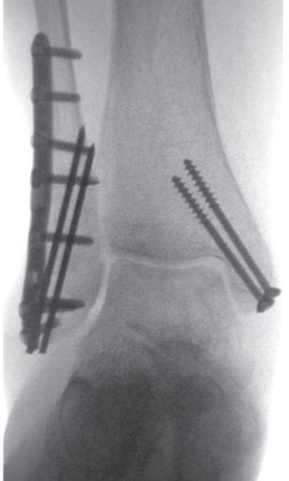
Fixation technique Plate + 2 K-wires
From inf. Lat. to medial cortex
Increase stability, 81%
Torsional stability, 200%
Rammelt, Stefan. "Management of ankle fractures in the elderly." EFORT Open Reviews 1.5 (2016): 239-246
Koval, Kenneth J., et al. "A new technique for complex fibula fracture fixation in the elderly: a clinical and biomechanical evaluation." Journal of orthopaedic trauma 11.1 (1997): 28-33.
Notes:
Increase stability by 81% (p<0.05) and torsional stability by 200% (P<0.02) as compared to a one-third tubular plate alone.35

Slide 13
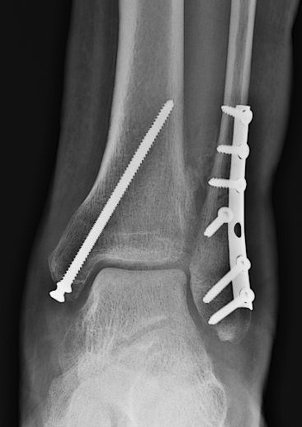
Fixation techniques
Oblique fractures, additional inter fragmentary compression screw
Weber, Martin, and Fabian Krause. "Peroneal tendon lesions caused by antiglide plates used for fixation of lateral malleolar fractures: the effect of plate and screw position." Foot & ankle international 26.4 (2005): 281-285.
Notes:
The use of a posterior anti-glide plate on the distal fibular plate provides more biomechanical stability than a conventional or locking lateral plate.28,29 . In oblique fractures, an additional inter fragmentary compression screw may be avoid irritation of the peroneal tendons.30 .
Posterolateral approach to the fibula provides a better soft tissue protection for the plate than a lateral approach, which is of particular advantage in elderly patients with frail skin. use of a hook plate.2,37
Schaffer, JOHN J., and A. Manoli. "The antiglide plate for distal fibular fixation. A biomechanical comparison with fixation with a lateral plate." J Bone Joint Surg Am 69.4 (1987): 596-604.

Slide 14
Fixation technique Posterior plating of the fibula
Posterolateral approach
Better soft tissue protection
More biomechanical stability
Weber, Martin, and Fabian Krause. "Peroneal tendon lesions caused by antiglide plates used for fixation of lateral malleolar fractures: the effect of plate and screw position." Foot & ankle international 26.4 (2005): 281-285.
Notes:
The use of a posterior anti-glide plate on the distal fibular plate provides more biomechanical stability than a conventional or locking lateral plate.28,29 . In oblique fractures, an additional inter fragmentary compression screw may be avoid irritation of the peroneal tendons.30 .
Posterolateral approach to the fibula provides a better soft tissue protection for the plate than a lateral approach, which is of particular advantage in elderly patients with frail skin.

Slide 15
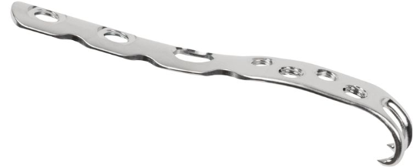
Fixation technique hook plate
Simple option
fixation enhancement
Schaffer, JOHN J., and A. Manoli. "The antiglide plate for distal fibular fixation. A biomechanical comparison with fixation with a lateral plate." J Bone Joint Surg Am 69.4 (1987): 596-604.
Notes:
The use of a posterior anti-glide plate on the distal fibular plate provides more biomechanical stability than a conventional or locking lateral plate.28,29 . In oblique fractures, an additional inter fragmentary compression screw may be avoid irritation of the peroneal tendons.30 .
Posterolateral approach to the fibula provides a better soft tissue protection for the plate than a lateral approach, which is of particular advantage in elderly patients with frail skin. use of a hook plate.2,37
Schaffer, JOHN J., and A. Manoli. "The antiglide plate for distal fibular fixation. A biomechanical comparison with fixation with a lateral plate." J Bone Joint Surg Am 69.4 (1987): 596-604.

Slide 16
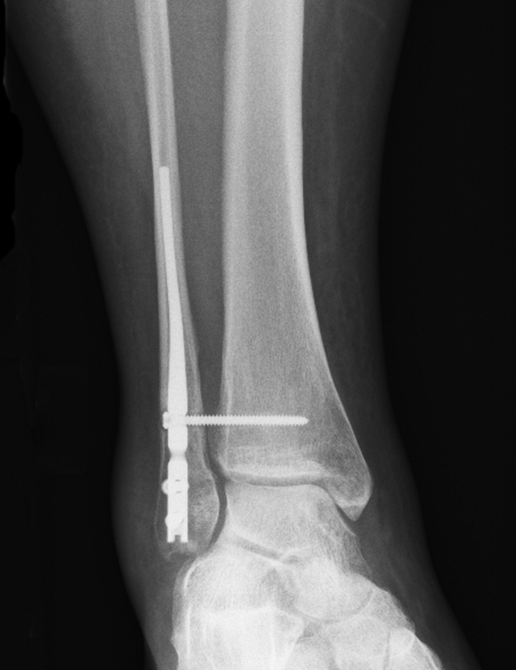
Fixation techniques Intramedullary fibular nail
Vulnerable skin condition
Minimize soft tissue compromise
Rajeev, Aysha, et al. "Functional outcomes after fibula locking nail for fragility fractures of the ankle." The Journal of Foot and Ankle Surgery 50.5 (2011): 547-550.
Notes:
Intramedullary fibular nail may be used to minimize soft tissue compromise.36

Slide 17
Fixation technique Tibial cortex progression of fibular screw
Week quality of fibula for screw fixation

Slide 18
Fixation techniques Direct fixation of the posterior tibial fragment
Syndesmotic stabilization
Re-establishment of the integrity and physiological tension of the syndesmosis
In the case of fibular fx., post. tibial plating by posterolateral approach
Gardner, Michael J., et al. "Fixation of posterior malleolar fractures provides greater syndesmotic stability." Clinical orthopaedics and related research447 (2006): 165-171.
Notes:
Recently, the role of direct stabilization of the posterior tibial fragment has gained increased attention.21-23
fixation of the posterior fragment will re-establish the integrity and physiological tension of the tibiofibular syndesmosis.31
The strong posterior tibiofibular lig. inserts at the post.lat. tibial margin
Rammelt, S., H. Zwipp, and T. Mittlmeier. "[Operative treatment of pronation fracture--dislocations of the ankle]." Operative Orthopadie und Traumatologie25.3 (2013): 273-91.
Bartoníček, Jan, et al. "Anatomy and classification of the posterior tibial fragment in ankle fractures." Archives of orthopaedic and trauma surgery135.4 (2015): 505-516.

Slide 19
10 days later
Why?
Too short plate
No fixation of Post. Mall.
80 y female

Slide 20
6 weeks after revision

Slide 21
Fixation techniques Cement augmentation
Severely osteoporotic bone
Screws insertion into the cement prior to hardening
Alternatively, drilling the hardened cement and screw fixation
Resorbable calcium phosphate cement with gradual replacement by bone
Rammelt, Stefan. "Management of ankle fractures in the elderly." EFORT Open Reviews 1.5 (2016): 239-246

Slide 22
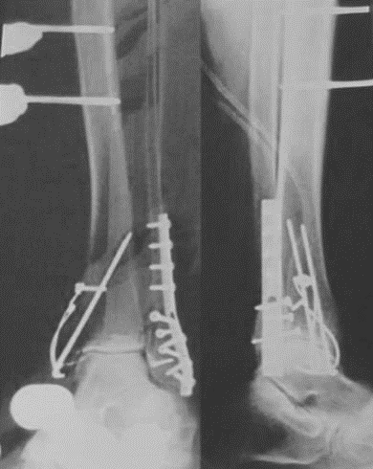
Fixation techniques Supplementary ext. fixation
Hybrid fixation to get more stability
Tibio metatarsal fixation
Rammelt, Stefan. "Management of ankle fractures in the elderly." EFORT Open Reviews 1.5 (2016): 239-246

Slide 23
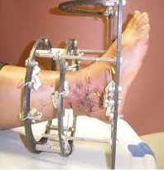
Fixation techniques Ilizarov frame
In Charcot foot arthropathy
Pinzur, Michael S. "The role of ring external fixation in Charcot foot arthropathy." Foot and ankle clinics 11.4 (2006): 837-847.

Slide 24
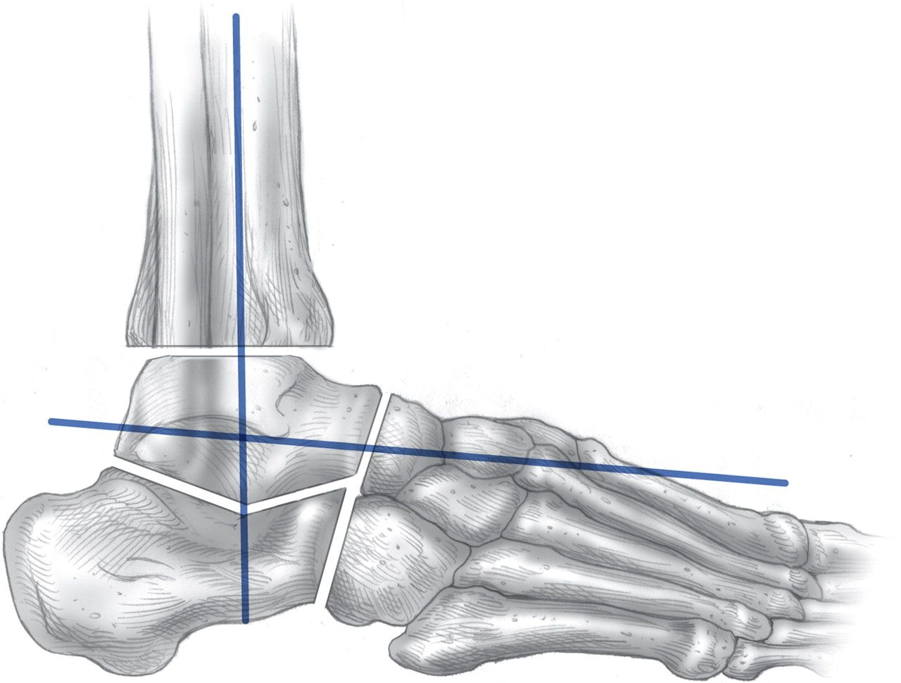
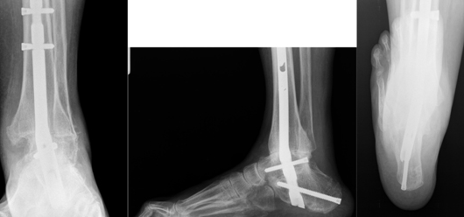
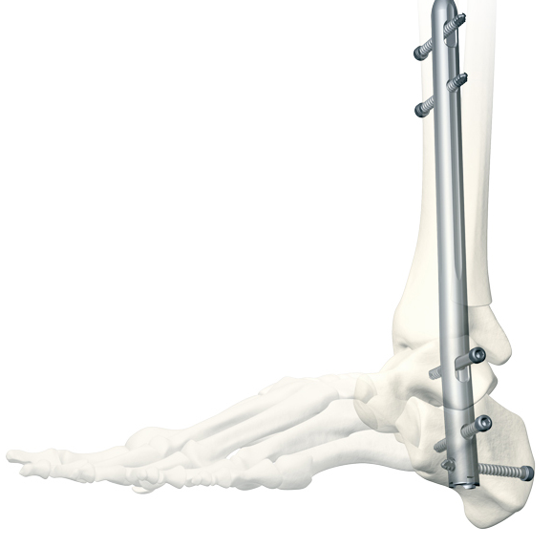
Fixation techniques Tibio-talo-calcaneal fusion
High stability
Retrograde curved nail from calcaneum to tibia
Excellent treatment option for Charcot neurogenic osteoarthropathy
Rammelt, S., H. Zwipp, and W. Schneiders. "Treatment strategies for Charcot-osteoarthropathy." Osteologie 23 (2014): 107-16.
Al-Nammari, S. S., et al. "Fragility fractures of the ankle in the frail elderly patient." Bone Joint J 96.6 (2014): 817-822.
Notes:
Provide high stability. Excellent treatment option for patients with Charcot neurogenic osteoarthropathy of the ankle/hindfoot type (Sanders IV), because standard techniques of internal fixation will invariably fail in these patients.17Alternatively, a small wire external fixator may be used.42
Nail insertion along calcaneal axix(12degree of valgus). it should only be an option in bedridden patients.41

Slide 25
Post-operative treatment
Active compliant patients Partial WB(20kg) for 6-8 weeks in a boot walker
Frail incompliant patients Offloading in a short leg cast for 8 weeks
Severe osteoporosis Offloading in a TCC for 12 weeks
Diabetic neuropathy Offloading in a TCC for 12 weeks
Notes:
Frequently, elderly patients will not be able to partially offload their leg and should therefore rather be subjected to off-loading until bony union.

Slide 26
Post-operative treatment
Comorbidities treatment
Blood glucose levels control
Osteoporotic fracture Routine BMD and adequate medication
Smoking and alcohol cessation
Physical activity
Notes:
Routine BMD and adequate medication are mandatory after osteoporotic fractures.

Slide 27
Take home message
Displaced fx. Significantly better results by ORIF
ORIF general indication No differ in elderly from younger patient
Individual treatment Bone quality, overall condition, functional demand
Charcot arthropathy detection Special treatment
Stable fixation
Co -morbidities treatment
Osteoporosis
Blood glucose levels
…
Notes:
Individual treatment tailored to bone quality, overall condition, functional demand

Slide 28
Thanks for your attention

